Slide 1
Unit V
Data Link Control
Vinit R Tribhuvan
vrt22.comp@coep.ac.in
1
Notes:
Data Communication

Slide 2
Data Link Layer
Communication at the data-link layer is node-to-node.
A data unit from one point in the Internet needs to pass through many networks (LANs and WANs) to reach another point. Theses LANs and WANs are connected by routers.
The data-link layer is located between the physical and the network layers.
The datalink layer provides services to the network layer;
It receives services from the physical layer.
the data-link layer of a node (host or router) is responsible for delivering a datagram to the next node in the path.
first service provided by the data-link layer is framing. It encapsulates the datagram in a frame before sending it to a frame.
A packet at the data-link layer is normally called a frame.
2
Notes:
Data Communication

Slide 3
Data Link Layer
Flow control - If the rate of produced frames is higher than the rate of consumed frames, frames at the receiving end need to be buffered while waiting to be consumed (processed).
Error control - error detection and correction is an issue in every layer. The error needs first to be detected. After detection, it needs to be either corrected at the receiver node or discarded and retransmitted by the sending node.
3
Notes:
Data Communication

Slide 4
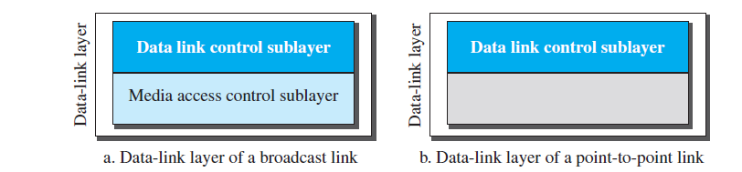
We study the data-link layer into two sublayers: data link control (DLC) and media access control (MAC).
The data link control sublayer deals with all issues common to both point-to-point and broadcast links;

Slide 5
Data Link Control (DLC)

Slide 6
DLC Services
Framing
Flow Control
Error Control
Connectionless and Connection Oriented

Slide 7
Framing
Pack bits into frames.
For instance, postal system practices a type of framing.
Framing in the data-link layer separates a message from one source to a destination by adding a sender address and a destination address.
destination address defines where the packet is to go; sender address helps the recipient acknowledge the receipt.
Frame size acts like a delimiter.
The size of a fixed size frame acts like a delimiter.

Slide 8
Variable sized framing
Two approaches :
character-oriented approach
bit-oriented approach.

Slide 9
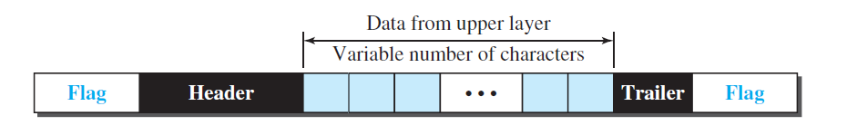
Character oriented approach
Character-oriented (or byte-oriented) framing
Data is usually 8 bit character (ASCII)
Header – source and destination address
Trailer - carries error detection redundant bits
To separate frames, 8-bit (1-byte) flag is added at the beginning and the end of a frame.
The flag, composed of protocol-dependent special characters, signals the start and end of the frame.

Slide 10
Problem?
any character used for the flag could also be part of the information.
the receiver, when it encounters this pattern in the middle of the data, thinks it has reached the end of the frame.

Slide 11
Byte Stuffing
Special byte is added to data section of a frame, when there is a character with the same pattern as the flag.
Data section is stuffed with an extra byte – escape character (ESC).
Whenever the receiver encounters the ESC character, it removes it from the data section and treats the next character as data.

Slide 12
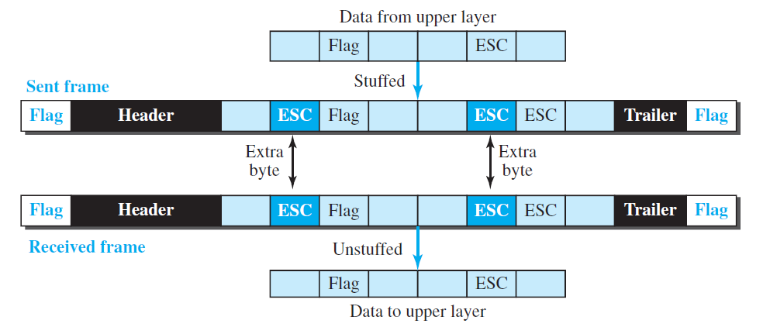

Slide 13
Byte stuffing is the process of adding one extra byte whenever there is a flag or escape character in the text.
What happens if the text contains one or more escape characters followed by a byte with the same pattern as the flag?
Solution - Receiver removes the escape character, but keeps the next byte, which is incorrectly interpreted as the end of the frame.
To solve this problem, the escape characters that are part of the text must also be marked by another escape character.
If the escape character is part of the text, an extra one is added to show that the second one is part of the text.

Slide 14
Another problem – We deal with Unicode, have 16-bit and 32-bit characters that conflict with 8-bit characters.

Slide 15
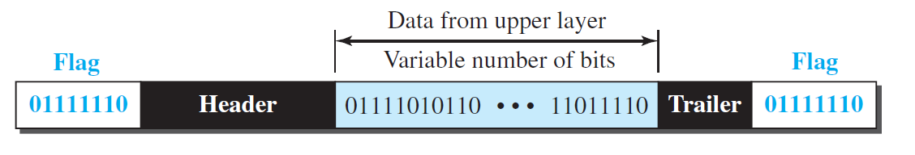
Bit oriented Framing
the data section of a frame is a sequence of bits to be interpreted by the upper layer as text, graphic, audio, video.
in addition to headers (and possible trailers), we still need a delimiter to separate one frame from the other.
use a special 8-bit pattern flag, 01111110, as the delimiter

Slide 16
Bit stuffing
Can create the same problem as in character-oriented protocol
If flag-pattern appears in the data, it has to be informed that it is not the end.
Solution – stuff one extra bit to prevent the pattern look like a flag.

Slide 17
In bit stuffing, if a 0 and five consecutive 1 bits are encountered, an extra 0 is added.
extra stuffed bit is eventually removed from the data by the receiver.
the extra bit is added after one 0 followed by five 1s regardless of the value of the next bit.

Slide 18
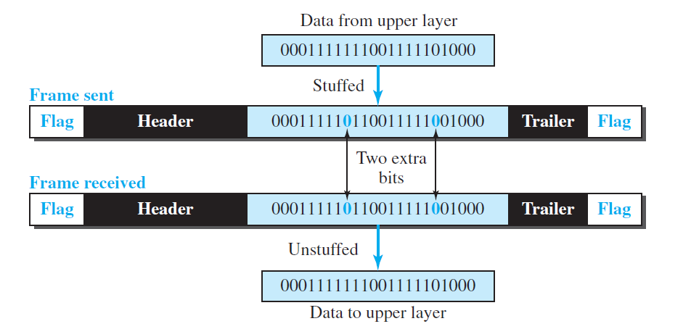
Bit stuffing and unstuffing
if the flaglike pattern 01111110 appears in the data, it will change to 011111010 (stuffed) and is not mistaken for a flag by the receiver.

Slide 19
Flow control
A basic producer – consumer problem
There must be a balance.
If the items are produced faster than they can be consumed, the consumer can be overwhelmed and may need to discard some items.
Flow control is required to prevent loss of data at receiver site.

Slide 20
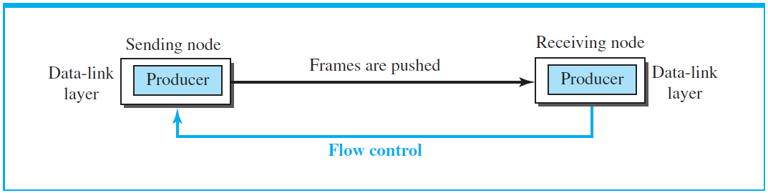
concentrate on the relationship between two data-link layers, as shown in Figure

Slide 21
the data-link layer at the sending node tries to push frames toward the data-link layer at the receiving node.
If the receiving node cannot process and deliver the packet to its network at the same rate that the frames arrive, it becomes overwhelmed with frames.
Flow control in this case can be feedback from the receiving node to the sending node to stop or slow down pushing frames.

Slide 22
Buffering
one of the solutions is normally to use two buffers; one at the sending data-link layer and the other at the receiving data-link layer.
A buffer is a set of memory locations that can hold packets at the sender and receiver.
The flow control communication can occur by sending signals from the consumer to the producer.
When the buffer of the receiving data-link layer is full, it informs the sending data-link layer to stop pushing frames.

Slide 23
Error control
There is a need to implement error control at the data-link layer to prevent the receiving node from delivering corrupted packets to its network layer.
Method 1 - if the frame is corrupted, it is silently discarded; if it is not corrupted, the packet is delivered to the network layer. This method is used mostly in wired LANs such as Ethernet.
Method 2 - if the frame is corrupted, it is silently discarded; if it is not corrupted, an acknowledgment is sent (for the purpose of both flow and error control) to the sender.

Slide 24
Flow and error control can be combined. In a simple situation, the acknowledgment that is sent for flow control can also be used for error control to tell the sender the packet has arrived uncorrupted.
A frame that carries an acknowledgment is normally called an ACK to distinguish it from the data frame.

Slide 25
A DLC protocol can be either connectionless or connection-oriented

Slide 26
Connectionless
In a connectionless protocol, frames are sent from one node to the next without any relationship between the frames; each frame is independent.
Note that the term connectionless here does not mean that there is no physical connection (transmission medium) between the nodes; it means that there is no connection between frames.
The frames are not numbered and there is no sense of ordering.
Most of the data-link protocols for LANs are connectionless protocols

Slide 27
Connection oriented
a logical connection should first be established between the two nodes (setup phase). After all frames that are somehow related to each other are transmitted (transfer phase), the logical connection is terminated (teardown phase).
the frames are numbered and sent in order. If they are not received in order, the receiver needs to wait until all frames belonging to the same set are received and then deliver them in order to the network layer.
Connection oriented protocols are used in in some point-to-point protocols, some wireless LANs, and some WANs.

Slide 28
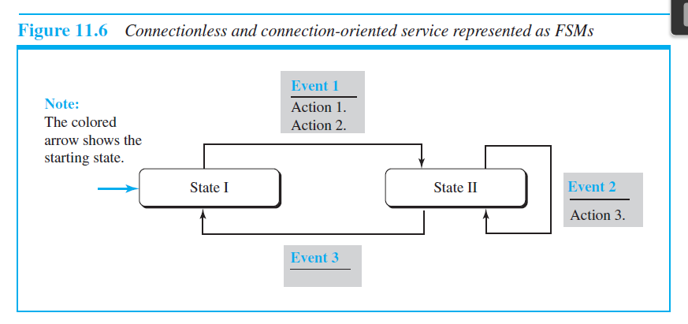
Protocols
The behavior of a data-link-layer protocol can be better shown as a finite state machine (FSM).

Slide 29
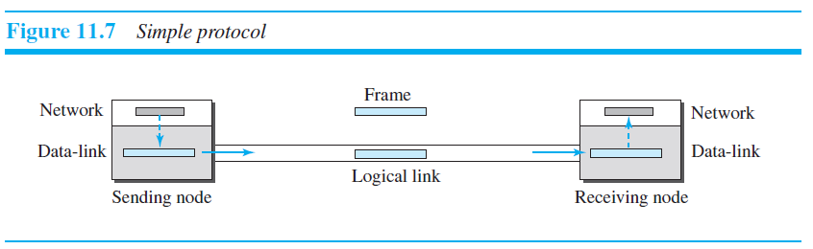
Simple protocol
simple protocol with neither flow nor error control.
the receiver can immediately handle any frame it receives.

Slide 30
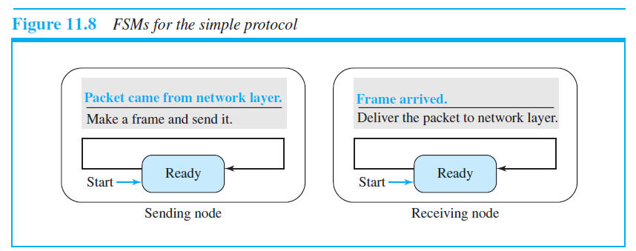
FSM for simple protocol

Slide 31
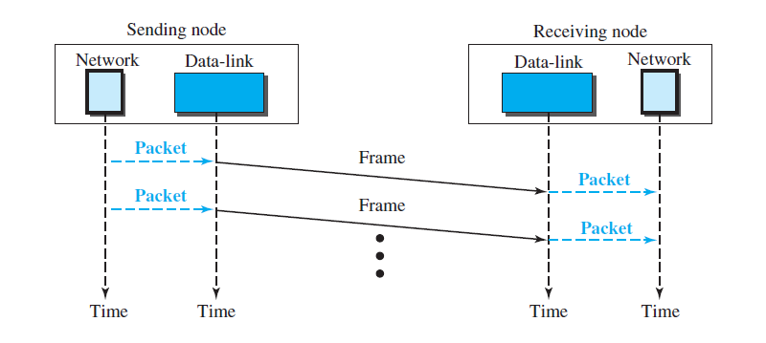
Flow diagram for simple protocol

Slide 32
Stop and Wait protocol
Sender sends a frame at a time
Sender stops and waits for acknowledgement before sending next one
CRC is used to detect corrupted frames
If its CRC is incorrect, the frame is corrupted and silently discarded
The silence (no response) from receiver is a signal that packet was discarded or lost.

Slide 33
Stop and Wait protocol
Sender starts a timer every time it sends a frame.
If acknowledgment is received from reciver, timer is stopped and next frame is sent.
If the timer expires, the sender resends the previous frame.
Sender keeps a copy of frame until acknowledgement arrives.
It discards the copy when acknowledgement is received.

Slide 34
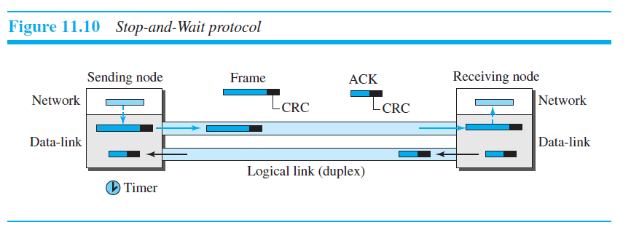
Stop and Wait protocol

Slide 35
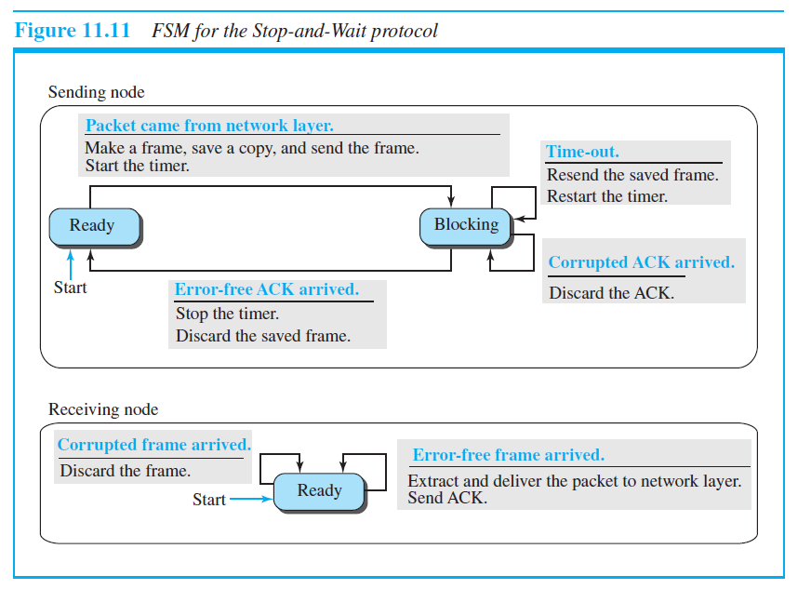
FSM for stop and wait protocol

Slide 36
Sender states
Ready state
When the sender is in this state, it is only waiting for a packet from the network layer.
If a packet comes from the network layer, the sender creates a frame, saves a copy of the frame, starts the only timer and sends the frame.
The sender then moves to the blocking state.
Blocked State
If a time-out occurs, the sender resends the saved copy of the frame and restarts the timer.
If a corrupted ACK arrives, it is discarded.
If an error-free ACK arrives, the sender stops the timer and discards the saved copy of the frame. It then moves to the ready state.

Slide 37
Receiver state
The receiver is always in the ready state. Two events may occur:
If an error-free frame arrives, the message in the frame is delivered to the network layer and an ACK is sent.
If a corrupted frame arrives, the frame is discarded.

Slide 38
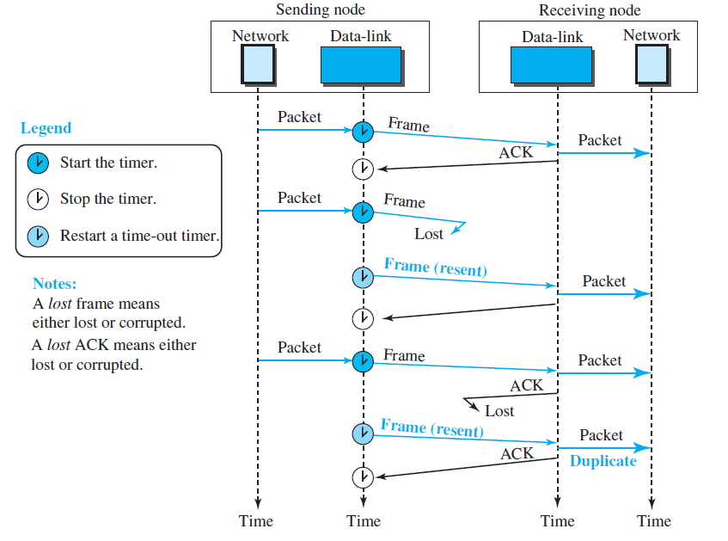

Slide 39
High-level Data Link Control (HDLC)
bit-oriented protocol for communication over point-to-point and multipoint links.
implements the Stop-and-Wait protocol
Works in two common transfer modes:
normal response mode (NRM)
asynchronous balanced mode (ABM)

Slide 40
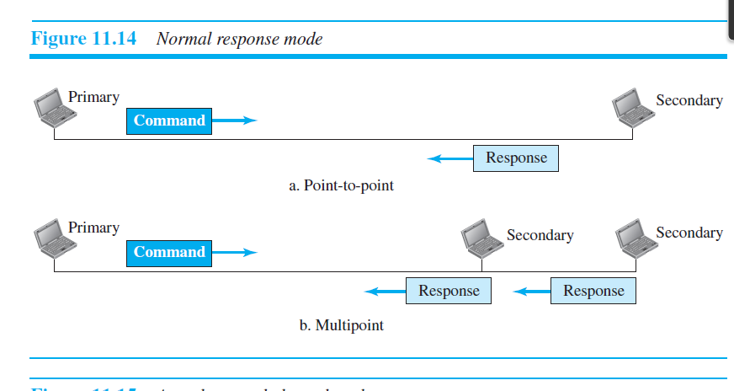
Normal Response Mode
In normal response mode (NRM), the station configuration is unbalanced. We have one primary station and multiple secondary stations. A primary station can send commands; a secondary station can only respond. The NRM is used for both point-to-point and multipoint links.

Slide 41
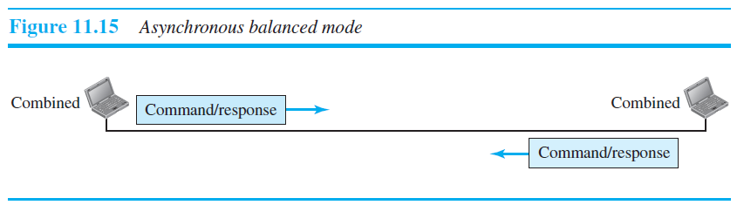
Asynchronous Balanced Mode
In ABM, the configuration is balanced. The link is point-to-point, and each station can function as a primary and a secondary (acting as peers).

Slide 42
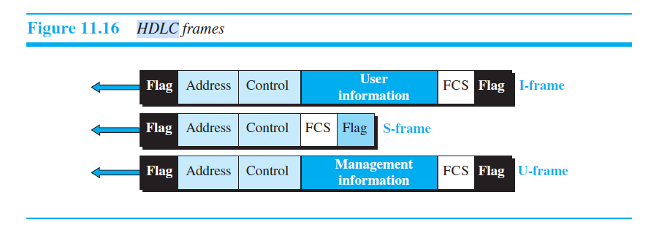
HDLC Frames

Slide 43
Flag - This field contains synchronization pattern 01111110 (beginning and end of frame)
Address - contains the address of the secondary station. If a primary station created the frame, it contains a to address. If a secondary station creates the frame, it contains a from address. The address field can be one byte or several bytes long.
Control field. The control field is one or two bytes used for flow and error control.
Information field. The information field contains the user’s data from the network layer or management information.
FCS field. The frame check sequence (FCS) is the HDLC error detection field. It can contain either a 2- or 4-byte CRC.

Slide 44
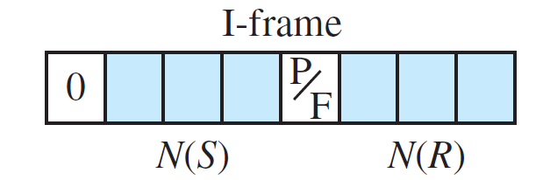
Control Field format
Instructional Frame(I frame)

Slide 45
Instructional Frame(I frame)
The first bit defines the type. If the first
bit of the control field is 0, this means the frame
is an I-frame
The next 3 bits, called N(S), define the sequence number of the frame.
The last 3 bits, called N(R), correspond to the acknowledgment number.
The single bit between N(S) and N(R) is called the P/F(poll/final) bit.
It has meaning only when it is set (bit = 1).
It means poll when the frame is sent by a primary station to a secondary (when the address field contains the address of the receiver). It means final when the frame is sent by a secondary to a primary (when the address field contains the address of the sender).

Slide 46
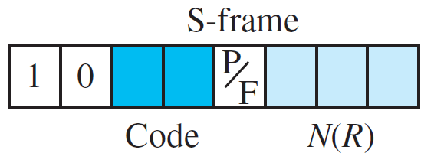
Supervisory frame

Slide 47

Supervisory frame
the first 2 bits of the control field are 10,
this means the frame is an S-frame.
The 2 bits called code are used to define the type of S-frame itself.
Receive ready (RR). If the value of the code subfield is 00, it is an RR S-frame.
This kind of frame acknowledges the receipt of a safe and sound frame or group of frames. In this case, the value of the N(R) field defines the acknowledgment number.
Receive not ready (RNR). If the value of the code subfield is 10, it is an RNR Sframe. This kind of frame is an RR frame with additional functions. It acknowledges the receipt of a frame or group of frames, and it announces that the receiver is busy and cannot receive more frames. It acts as a kind of congestion-control mechanism by asking the sender to slow down. The value of N(R) is the acknowledgment number.

Slide 48
Supervisory frame
Reject (REJ). If the value of the code subfield is 01,
it is an REJ S-frame. This is a
NAK frame. It is a NAK thatbefore the sender timer expires, that the last frame is lost or damaged. The value of N(R) is the negative acknowledgment number.
Selective reject (SREJ). If the value of the code subfield is 11, it is an SREJ Sframe.
This is a NAK frame used in Selective Repeat ARQ. Note that the HDLC Protocol uses the term selective reject instead of selective repeat. The value of N(R) is the negative acknowledgment number.

Slide 49
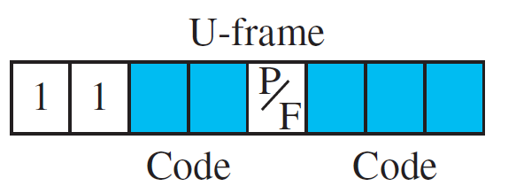
Unnumbered frame

Slide 50
Unnumbered frame
Unnumbered frames are used to exchange session management and control information between connected devices.
U-frames contain an information field, but one used for system management information
much of the information carried by U-frames is contained in codes included in the control field
these two segments (2+3 bits) can be used to create up to 32 different types of U-frames.

Slide 51
Point to point (PPP) protocol
Services at DLL
control and manage the transfer of data at DLL
Provides authentication, network address configuration (for temporary addresses)
DOES NOT provide flow control.
DOES NOT provide a sophisticated addressing mechanism to handle frames.

Slide 52
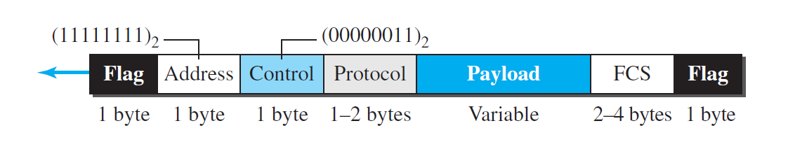
Framing
PPP Frame format

Slide 53
Address. The address field in this protocol is a constant value and set to 11111111
(broadcast address).
Control. This field is set to the constant value 00000011 (imitating unnumbered
frames in HDLC).
Protocol. The protocol field defines what is being carried in the data field: either
user data or other information.
Payload field. This field carries either the user data or other information.(maximum of 1500 bytes).
FCS. The frame check sequence (FCS) is simply a 2-byte or 4-byte standard CRC.
Note: Byte stuffing is done in PPP.

Slide 54
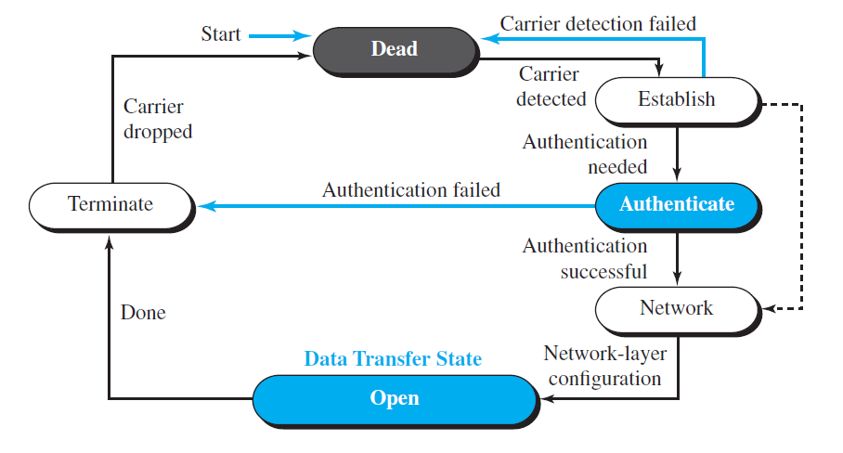
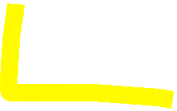
FSM for PPP

Slide 55
Dead state - there is no active carrier (at the physical layer) and the line is quiet.
Establish state - When one of the two nodes starts the communication, the connection goes into this state. Negotiation is done for authenthentication and followed by agreement. Several link-control protocol packets are exchanged here.
Open state - Data transfer takes place in the open state. The connection remains in this state until one of the endpoints wants to terminate the connection. The system remains in this state until the carrier (physical-layer signal) is dropped, which moves the system to the dead state again.

Slide 56
Three sets of protocols are defined to make PPP powerful:
the Link Control Protocol (LCP)
Two Authentication Protocols (APs)
Network Control Protocols (NCPs).

Slide 57
Link Control Protocol (LCP)
The Link Control Protocol (LCP) is responsible for
establishing
maintaining
configuring
terminating communication links.

Slide 58
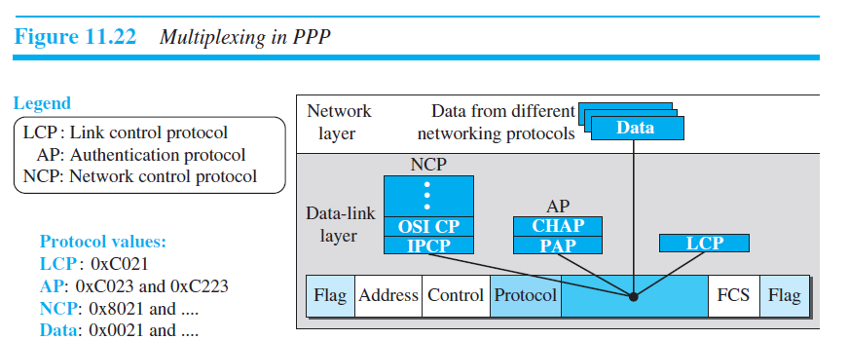
Multiplexing in PPP

Slide 59
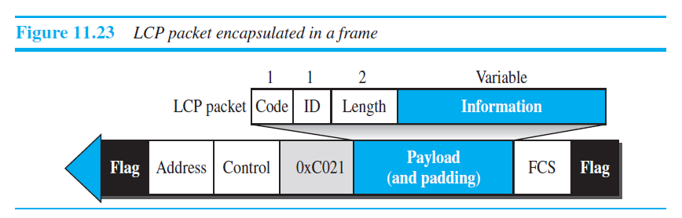
All LCP packets are carried in the payload field of the PPP frame with the protocol field set to 0xC021 in hexadecimal.

Slide 60
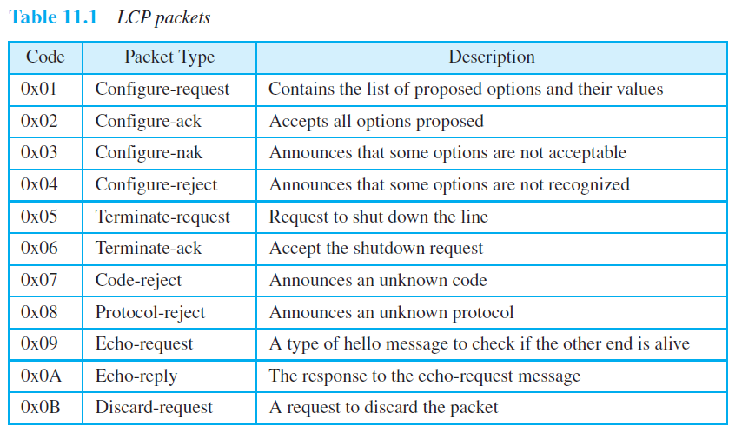
Code field in LCP

Slide 61
the first four packet types, is used for link configuration during the establish phase.
The second category, comprising packet types 5 and 6, is used for link termination during the termination phase.
The last five packets are used for link monitoring and debugging.
The ID field holds a value that matches a request with a reply.
The length field defines the length of the entire LCP packet.
The information field contains information, such as options, needed for some LCP packets
Options are inserted in the information field of the configuration packets, For this, information field is divided into three fields: option type, option length, and option data.

Slide 62
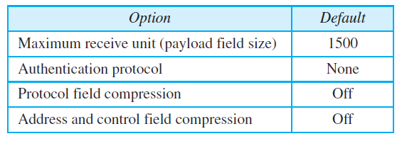
Common options
Options are inserted in the information field of the configuration packets, For this, information field is divided into three fields: option type, option length, and option data.

Slide 63
Authentication protocols in PPP
PPP has created two protocols for authentication:
Password Authentication Protocol (PAP)
Challenge Handshake Authentication Protocol (CHAP)

Slide 64
Password Authentication Protocol (PAP)
The Password Authentication Protocol (PAP) is a simple authentication procedure with a two-step process:
The user who wants to access a system sends an authentication identification (usually the user name) and a password.
The system checks the validity of the identification and password and either accepts or denies connection.

Slide 65
Frames in PAP
When a PPP frame is carrying any PAP packets, the value of the protocol field is 0xC023
Three PAP packets are
authenticate-request(used by the user to send the user name and password)
authenticate-ack(used by the system to allow access)
authenticate-nak(used by the system to deny access).

Slide 66
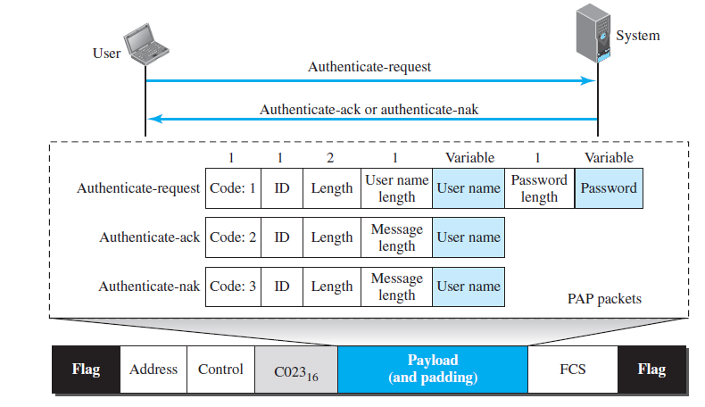
PAP in PPP frame

Slide 67



Challenge Handshake Authentication Protocol (CHAP)
CHAP frames are exchanged during the peer authentication phase, when peer authentication based on the Challenge-Handshake Authentication Protocol (CHAP) is requested as one of the configuration options during the link establishment phase
three-way handshaking authentication protocol.
Provides greater security – password is kept secret – never sent online

Slide 68
The system sends the user a challenge packet containing a challenge value, usually a few bytes.
The user applies a predefined function that takes the challenge value and the user’s own password and creates a result. The user sends the result in the response packet to the system.
The system does the same. It applies the same function to the password of the user (known to the system) and the challenge value to create a result. If result is same, access is granted, else denied.

Slide 69
CHAP packets are encapsulated in the PPP frame with the protocol value 0xC223 in
hexadecimal.
There are four CHAP packets:
Challenge(used by the system to send the challenge value)
Response(is used by the user to return the result of the calculation)
Success (used by the system to allow access to the system)
Failure (is used by the system to deny access to the system)

Slide 70
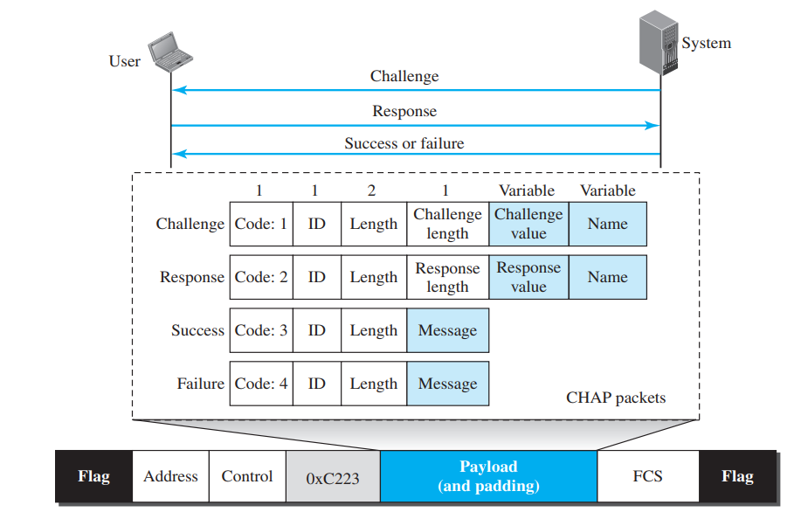
CHAP Packets

Slide 71
Network Control Protocols

Slide 72

Internet Protocol Control Protocol (IPCP)
IPCP configures the link used to carry IP packets in the Internet.
The Internet Protocol Control Protocol (IPCP) is used to configure, enable, and disable IP over PPP links. It uses the same frame exchange mechanism as the link control protocol (LCP).

Slide 73
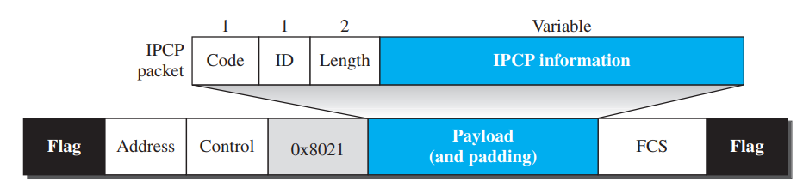
the value of the protocol field in hexadecimal is 0x8021

Slide 74
Address Field
The address field is one octet in length, and is part of the HDLC-like framing for PPP. It is always set to 0xff.
Control Field
The control field is one octet in length, and is part of the HDLC-like framing for PPP. It is always set to 0x03.
Protocol Id
The protocol id identifies the type of information contained in the information field of the frame, and is always 0x8021 for IPCP frames.

Slide 75
Id Field
The id field is one octet in length, and carries an identifier that is used to match associated requests and replies.
Length Field
The length field is two octets in length, and indicates the total length of the IPCP frame including the code, id, length, and data fields. The length must not exceed the maximum receive unit (MRU).
Data Field
The data field is zero or more octets in length, as indicated by the length field. It contains the information associated with the frame, which may be configuration options, frame information, or simple data, in a format determined by the code field

Slide 76
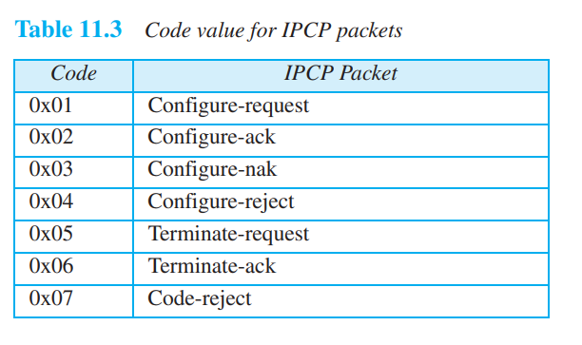

Slide 77
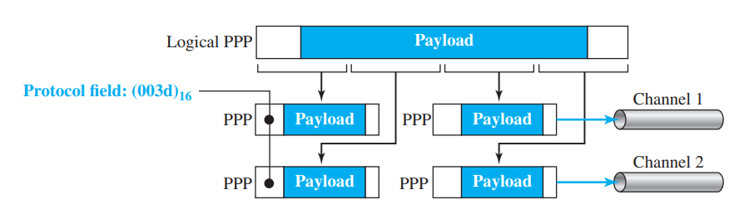
Multipo int PPP

